Slide 1
My portfolio
By Sreevidhya

Slide 2

Purpose
Purpose of my portfolio is to give a visual resume not to mention the first hand experience of my knowledge and experience with HTML and CSS for my potential employers.

Slide 3
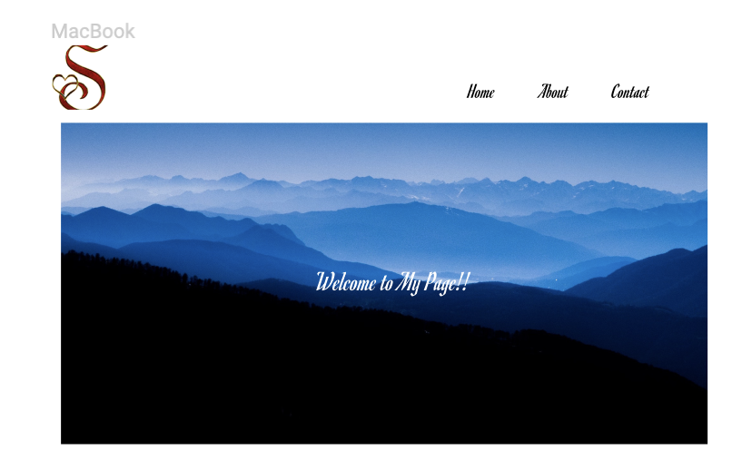
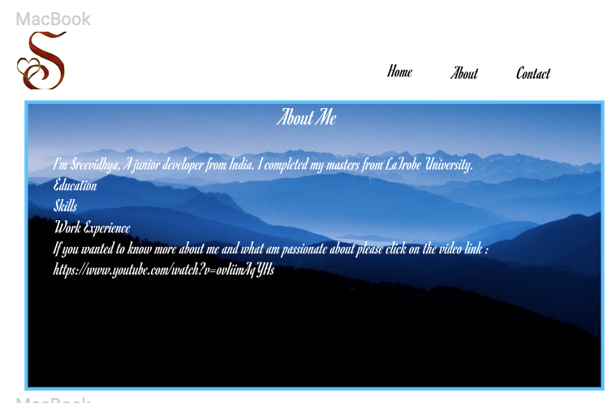
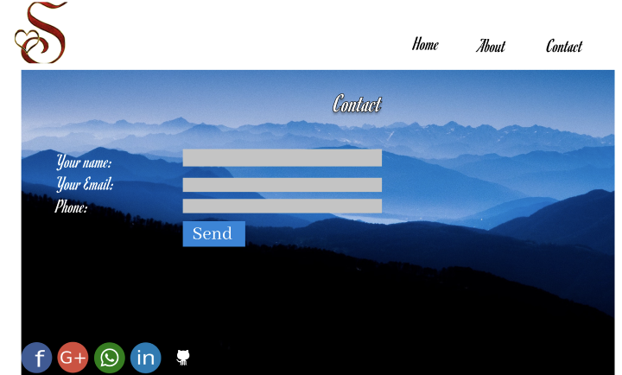
Design flow

Slide 4
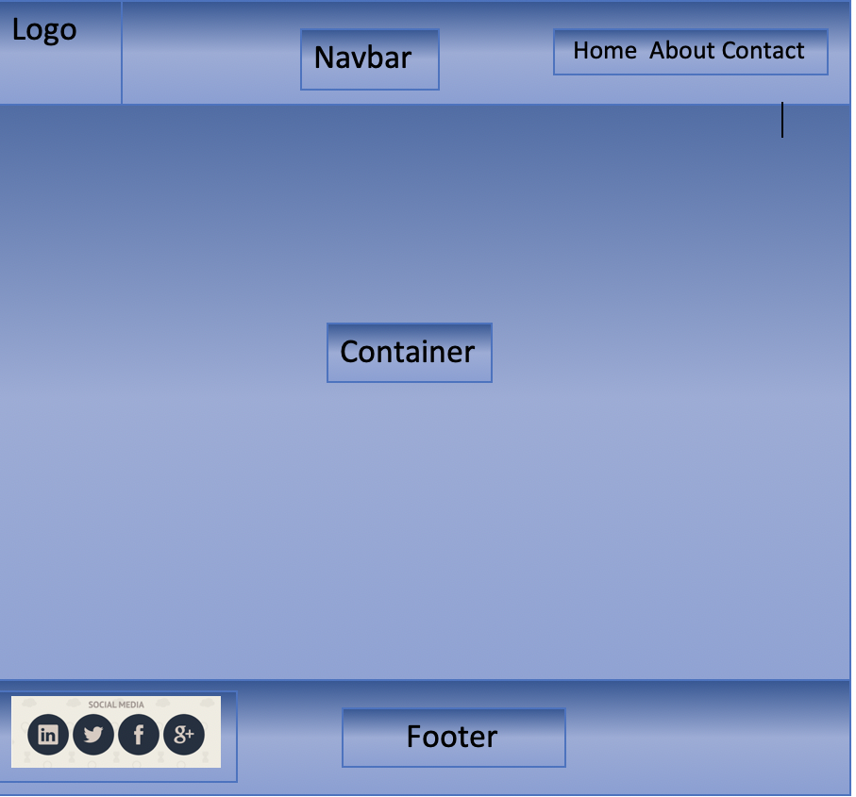
BASIC DESIGN

Slide 5


Difference between the three pages
Home page has my video resume
About me page information about me
Contact page has the form.
Other than this the rest all is the same.

Slide 6
Conclusion ?
Now let’s check out my portfolio: https://sreevidhya.co/home.html

